Slide 1
Ischemic conditioning –Evidence review

Slide 2
Overview
Concept of Ischemic conditioning
Evidence for ischemic conditioning in STEMI
  IPost
  RIC
  Combined
Evidence for ischemic conditioning in cardiac surgery
  IPost
  RIC
Pharmacological cardioprotection.
Remote ischemic conditioning
  Planned PCI
  Patients undergoing thrombolysis
RIC and renoprotection
Conclusions

Slide 3
Acute STEMI
Primary PCI Rx of choice
Reduces infarct size
7% mortality and 22% HF at 1 yr
Cardiac surgery
Global myocardial ischemia during cardiopulmonary bypass
ISCHEMIA REPERFUSION INJURY

Slide 4
Myocardial reperfusion injury
In 1985, Braunwald & Kloner wrote that “myocardial reperfusion may be viewed as a double-edged sword”.
Myocardial injury and cardiomyocyte death that paradoxically occurs with the acute reperfusion of ischaemic myocardium.
No treatment has been proven to be effective for preventing ‘myocardial reperfusion injury’.

Slide 5
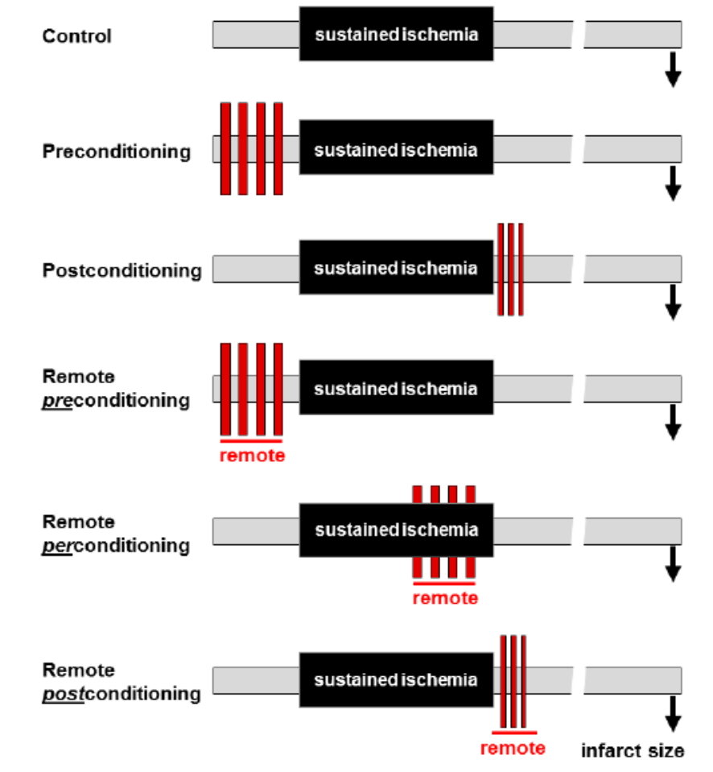
Ischemic conditioning
Cardioprotective role offered by subjecting an organ to brief periods of ischemia is ischemic conditioning.

Slide 6
Notes:
activation of G‑protein-coupled or cytokine receptors by autacoids such as adenosine, bradykinin, or opioids --------- recruitment of signalling pathways such as the Reperfusion Injury Salvage Kinase (RISK) pathway (PI3K–Akt and Mek1/2–Erk1/2), Survivor Activator Factor Enhancement (SAFE) pathway (TNF and JAK–STAT), and the cGMP–protein kinase G (PKG) pathway---------activate downstream mediators such as endothelial nitric oxide synthase (eNOS), glycogen synthase kinase (GSK)‑3β, hexokinase II (HKII), protein kinase Cε (PKCε), and the mitochondrial ATP-dependent potassium channel (K^{ATP}), which then mediate an inhibitory effect on mitochondrial permeability transition pore (MPTP) opening .

Slide 7
Ischemic conditioning stimulus shown to induce 2 separate windows of protection:
First window: classical or acute ischemic conditioning
  Immediately after conditioning stimulus
  Lasts 2-3 hrs; later wanes and disappears.
  Due to immediate alterations in the myocardium and coronary circulation.
Second window: delayed conditioning
  Occurs 12 -24 hrs after stimulus.
  Lasts 48-72 hrs.
  Due to changes in gene expression in cardiomyocytes.

Slide 8
Clinical applications
Notes:
Clinical settings in which they have been tested- dark blue.
Clinical settings in which they have shown potential- light blue.

Slide 9
IPost in STEMI

Slide 10
Notes:
Mixed results- differences in patient selection and Ipost protocol.
different end points.

Slide 11
Multicenter, prospective, randomized, open-label, blinded trial.
700 patients undergoing primary PCI for STEMI < 12 hours assigned to the postconditioning group or to the conventional primary PCI group in a 1:1 ratio.
TIMI 0-1 flow pre PCI.
Angioplasty balloon was positioned at the culprit lesion immediately after achieving coronary flow (>= TIMI 2) and inflated 4 times for 1 minute with low pressure (<6 atm) inflations, each separated by 1 minute of deflation.
Primary end point: complete ST resolution(>70%) at 60 mins.
Secondary end points:
  residual ST-segment deviation
  TIMI flow after PCI
  myocardial blush grade
  major adverse cardiac events (a composite of death, myocardial infarction, severe heart failure, or stent thrombosis) at 30 days.
Hahn, J. Y. et al. Ischemic postconditioning during primary percutaneous coronary intervention: the effects of postconditioning on myocardial reperfusion in patients with ST‑segment elevation myocardial infarction (POST) randomized trial. Circulation 128, 1889–1896 (2013).

Slide 12
40.5% vs 41.5%; absolute difference 1.0%, p=0.79

Slide 13
Ischemic postconditioning did not improve myocardial reperfusion in patients with STEMI undergoing primary PCI.

Slide 14
IPost in STEMI
What do the meta analyses say?

Slide 15
RCTs assessing effect of postconditioning on infarct size assessed.
Notes:
When more than 1 method used CMR>SPECT> CK/trop AUC.

Slide 16
When accurate assessment of anatomic infarct size was used (CMR studies), postconditioning had no effects on infarct size reduction.

Slide 17
10 RCTs
Studies reporting adverse cardiac events like deaths, heart failure, TVR, stent thrombosis, nonfatal reinfarction were included.

Slide 18
Use of postconditioning in patients with STEMI associated with significant decrease in heart failure, but risk of nonfatal MI may increase.
Effect on other end points neutral.

Slide 19
RIC in STEMI

Slide 20
Notes:
Proof of concept trials

Slide 21
333 patients with first STEMI for primary PCI
Randomised to RIC vs control.
Primary endpoint was major adverse cardiac and cerebrovascular events (MACCE)—a composite of all-cause mortality, myocardial infarction, readmission for heart failure, and ischaemic stroke/transient ischaemic attack.
Median follow up time: 3.8 yrs.
Sloth, A. D. et al. Improved long-term clinical outcomes in patients with ST‑elevation myocardial infarction undergoing remote ischaemic conditioning as an adjunct to primary percutaneous coronary intervention. Eur. Heart J. 35, 168–175 (2014).

Slide 22
Combined IPost + RIC in STEMI

Slide 23
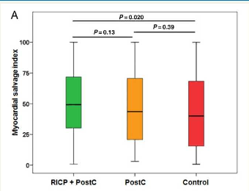
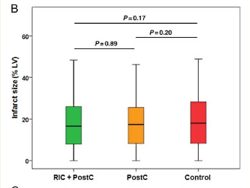
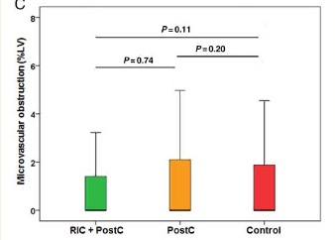
Prospective, controlled, single-centre study
Randomized 696 STEMI patients to one of the following three groups
  (i) combined intrahospital RIC + PostC in addition to primary PCI
  (ii) PostC in addition to PCI
  (iii) conventional PCI (control).
Primary endpoint :myocardial salvage index was assessed by CMR imaging within 3 days after infarction.
Secondary endpoints : infarct size and microvascular obstruction (MVO) assessed by CMR.
Combined clinical endpoint consisted of death, reinfarction and new congestive heart failure within 6 months.
RIPC + IPost 49 [interquartile range 30–72] vs. Control 40 [interquartile range 16–68]
P = 0.02
Eitel, I. et al. Cardioprotection by combined intrahospital remote ischaemic perconditioning and postconditioning in ST‑elevation myocardial infarction: the randomized LIPSIA CONDITIONING trial. Eur. Heart J. 36, 3049–3057 (2015).

Slide 24
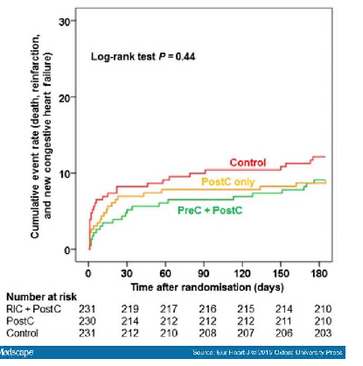
Combined RIC and PostC significantly increases myocardial salvage when compared with conventional PCI whereas PostC alone failed to demonstrate a cardioprotective effect in STEMI patients undergoing primary PCI.
Should be further investigated in future well-designed clinical trials powered for the clinical outcome

Slide 25
IPost in cardiac surgery

Slide 26
Therapeutic strategy for protecting against perioperative myocardial injury caused by the acute global IRI that occurs when a patient is put onto and taken off cardiopulmonary bypass.
Protocol requires 3 cycles of aorta clamping and unclamping 30 sec after cardiac surgery.
Translation of IPost for patients undergoing Sx difficult
  Invasive nature of the protocol.
  Potential risk of thromboembolic complications from manipulating an atherosclerotic aorta.
? Greater therapeutic potential in children undergoing corrective cardiac surgery for congenital heart disease
Notes:
Less chance of thromboembolism.

Slide 27
50 adult patients 18-60 yr with RHD for elective valve replacement.
2 groups of 25 each.
Luo, W., Li, B., Chen, R., Huang, R. & Lin, G. Effect of ischemic postconditioning in adult valve replacement. Eur. J. Cardiothorac. Surg. 33, 203–208 (2008)
Notes:
Postconditioning started 30 sec after cardioplegic arrest after surgery. Aortic root suctioning established during reclamping.

Slide 28
24 patients between 1-17 yrs with TOF.
1:1 for control and postconditioning.
2 cycles of aortic reclamping for 30 secs each.
No mortality or major complications in either group.
Study demonstrated that POC protects cyanotic myocardium undergoing cardioplegic arrest

Slide 29
RIC in cardiac surgery

Slide 30
First clinical application of RIC in humans.
RCT of RIPC in children undergoing repair of CHD.
4 cycles of 5 min lower limb ischemia and reperfusion using BP cuff.
37 patients (17= RIPC, 20=controls).
Study demonstrated the myocardial protective effects of RIPC.
Cheung, M. M. et al. Randomized controlled trial of the effects of remote ischemic preconditioning on children undergoing cardiac surgery: first clinical application in humans. J. Am. Coll. Cardiol. 47, 2277–2282 (2006)

Slide 31
Prospective, double-blind, multicenter, randomized, controlled trial involving adults scheduled for elective cardiac surgery requiring cardiopulmonary bypass.
Compared upper limb RIPC vs sham intervention.
1385 pts (692-RIPC, 693- control).
Primary end point: composite of death, myocardial infarction, stroke, or acute renal failure up to the time of hospital discharge.
Meybohm, P. et al. A multicenter trial of remote ischemic preconditioning for heart surgery. N. Engl. J. Med. 373, 1397–1407 (2015).

Slide 32
Multicenter, sham-controlled trial involving adults at increased surgical risk who were undergoing on-pump CABG.
1612 patients (811 in the control group and 801 in the ischemic- preconditioning group)
Combined primary end point was death from cardiovascular causes, nonfatal myocardial infarction, coronary revascularization, or stroke, assessed 12 months after randomization.
Hausenloy, D. J. et al. Remote ischemic preconditioning and outcomes of cardiac surgery. N. Engl. J. Med. 373, 1408–1417 (2015).
Notes:
EuroScore >5

Slide 33
RIC in cardiac surgery
Metaanalysis results?

Slide 34
23 trials of RIPC in 2200 patients undergoing major adult cardiovascular surgery.
Outcome measures: peri-operative death, myocardial infarction (MI), new-onset cardiac arrhythmia requiring treatment, cerebrovascular accident (CVA), renal failure requiring renal replacement therapy, mesenteric ischaemia, hospital stay and intensive care unit (ICU) stay.
Results: No significant difference in any of the outcome measures between the 2 groups.
Healy, D. A. et al. Remote preconditioning and major clinical complications following adult cardiovascular surgery: systematic review and meta-analysis. Int. J. Cardiol. 176, 20–31 (2014

Slide 35
Pharmacological cardioprotection

Slide 36
Cyclosporine A
Opening of the mitochondrial permeability transition pore (PTP) in the inner mitochondrial membrane plays a major role in reperfusion injury.
Inhibition of cyclophilin D, a major component of the PTP may reduce reperfusion injury.
Cyclosporine is a pharmacologic inhibitor of cyclophilin D.
Proof of concept phase 2 trial
  58 patients with acute STEMI
  Cyclosporine iv (2.5 mg/kg body weight) vs NS immediately before PCI
  Release of CK was significantly reduced (P=0.04) and Trop I was not significantly reduced (P=0.15).
  Infarct size on day 5 MRI in a subgroup of 27 pts was significantly reduced in cyclopsporine group( median 37g vs 46g, p=0.04)
Piot C, Croisille P, Staat P, et al. Effect of cyclosporine on reperfusion injury in acute myocardial infarction. N Engl J Med 2008; 359: 473-81.

Slide 37
CIRCUS trial no benefit
Multicenter, double-blind, randomized trial.
970 patients with acute AWSTEMI undergoing PCI within 12 hours.
1:1 to receive cyclosporine vs placebo.
Primary outcome was a composite of death from any cause, worsening of heart failure during the initial hospitalization, rehospitalization for heart failure, or adverse left ventricular remodeling at 1 year.
In patients with anterior STEMI who had been referred for primary PCI, intravenous
cyclosporine did not result in better clinical outcomes than those with placebo
Notes:
CIRCUS trial
Adverse left ventricular remodeling was defined as an increase of 15% or more in the left ventricular end-diastolic volume.

Slide 38
Therapeutic hypothermia
Combined Analysis of the RAPID MI-ICE and the CHILL-MI Trials
RCT of 140 patients.
Randomised 1: 1 to receive hypothermia vs standard care.
Hypothermia achieved with cool NS and Accutrol cooling catheter placed at IVC
Primary end point: infarct size measured by cardiac MRI at 4±2 days.
Patients with a large MaR defined as > 30% of LV had a significantly reduced IS/MaR of 26.5% by hypothermia (p = 0.03).
Notes:
MaR= T2 (rapid mi-ice) and sspe (chill-mi)
Infarct size = Late gadolinium enhancement

Slide 39
Main clinical endpoint, a combination of death and heart failure, was significantly reduced in the therapeutic hypothermia group, explained solely by a reduction in heart failure since there were no deaths in either arm.
All heart failure events occurred in patients with anterior STEMI ----- reduction in heart failure could be the result of a more pronounced IS reduction in anterior STEMIs.

Slide 40
Sodium nitrite
NIAMI trial – no benefit
RCT- 4 centres in UK and Australia.
229 pts with STEMI
1: 1 randomization to 70 µmol sodium nitrate iv infusion vs placebo.
Primary endpoint: difference in infarct size by CMR at 6-8 days.
Myocardial infarct size did not differ between nitrite and placebo groups (effect size = - 0.7% 95% CI: - 2.2%, +0.7%; P = 0.34)
Notes:
Nitrites in Acute Myocardial Infarction
Plasma nitrite is derived from oxidation of endothelially derived NO; shownto have vasorelaxant and anti-platelet
properties, that are enhanced by hypoxia

Slide 41
Notes:
EXAMI trial: exenatide does not improve myocardial salvage in STEMI patients successfully treated with primary PCI

Slide 42
RIC in planned PCI

Slide 44
5 studies with 731 patients were included.
Primary end point: periprocedural MI.
D’Ascenzo, F. et al. Cardiac remote ischaemic preconditioning reduces periprocedural myocardial infarction for patients undergoing percutaneous coronary interventions: a meta-analysis of randomised clinical trials. EuroIntervention 9, 1463–1471 (2014).

Slide 45
11 RCTs of 1713 patients.
Primary end points: perioperative MI and AKI.
Pei, H. et al. Remote ischemic preconditioning reduces perioperative cardiac and renal events in patients undergoing elective coronary intervention: a meta‑analysis of 11 randomized trials. PLoS ONE 9, e115500 (2014).
Notes:
Potential sources of heterogeneity.:male proportion

Slide 46
RIC in patients undergoing thrombolysis

Slide 47
RCT
519 STEMI patients for thrombolysis.
1:1 RIC vs control
Thrombolysis with SK
4 x 5 min cycles of upper limb conditioning.
Primary end point: enzymatic MI size as assessed by AUC serum troponin T and CK-MB measured at 0, 6,12, and 24 h.
Yellon, D. M. et al. Remote ischemic conditioning reduces myocardial infarct size in STEMI patients treated by thrombolysis. J. Am. Coll. Cardiol. 65, 2764–2765 (2015).
Notes:
MAURITIUS

Slide 48
Remote Ischemic Preconditioning
and Renoprotection

Slide 49
Remote ischemic preconditioning has been proposed to protect against ischemic and reperfusion insult.

Slide 50
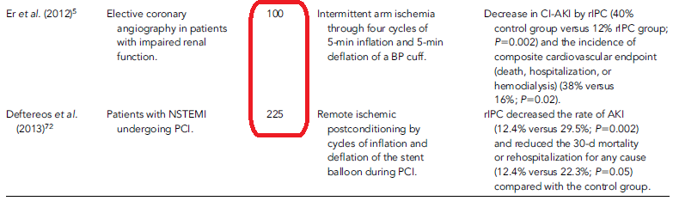
Contrast induced nephropathy
Notes:
Er et sl RenPro

Slide 51
Summary
STEMI
  IPost: Mixed results. Probably reduces new onset heart failure.
  RIC: Existing data suggests benefit. Reduces MACCE.
Cardiac Sx
  IPost: Proof of concept studies suggest cardioprotection and reduced need for postoperative inotropic support.
  RIC: No clinical benefit.
Pharmacologic cardioprotection
  Benefit from therapeutic hypothermia (especially with AWMI)
RIC
  Planned PCI: Existing data suggests benefit especially in males.
  Undergoing thrombolysis- ? Benefit – need more data.
Renoprotection
  Ischemic/ Reperfusion injury: mixed results
  CIN: Benefit

Slide 52
Conclusions
Ischaemic conditioning offers a powerful endogenous cardioprotective strategy.
  Reducing size of MI in patients with STEMI undergoing reperfusion
  Attenuating perioperative and periprocedural myocardial injury in patients undergoing CABG surgery or PCI.
The simplicity, noninvasive nature and the flexibility of the timing of the RIC stimulus, make it feasible to apply in many clinical scenarios.
Clinical studies have produced mixed results.
Most promising data exist for ischemic conditioning in patients with STEMI.

Slide 53
Major challenge facing research with a novel cardioprotection strategy
  Clinical outcomes of patients with STEMI after PPCI continue to improve; mortality rates after STEMI decreasing.
  Improvements in surgical techniques and advances in myocardial protection have reduced the extent of PMI together with patient mortality.
However, novel strategies needed
  The number of patients surviving a STEMI and subsequently developing heart failure is increasing.
  An ageing population and increasing prevalence of comorbidities, such as diabetes, obesity, and hypertension.
Such clinical endpoints(development of new HF) and high risk population should perhaps be the focus of future trials.

Slide 54
Ongoing Trials

Slide 55
EURO-CRIPS study: The EUROpean and Chinese cardiac and renal Remote Ischemic Preconditioning Study
555 patients with creat clearance 30-60 ml/min/1.73m2 for elective PCI.
3 × 5 min inflations/deflations of cuff on upper arm immediately before PCI
Primary endpoint: incidence of CIN
Secondary endpoint: periprocedural myocardial injury
ERIC‑PPCI trial: Effect of Remote Ischaemic Conditioning on Clinical Outcomes in STEMI Patients Undergoing PPCI
RCT with 4,300 All STEMI
4 × 5 min inflations/deflations of cuff on upper arm before PPCI
Primary end point of cardiac death and HHF at 12 months

Slide 56
THANK YOU

